Slide 1
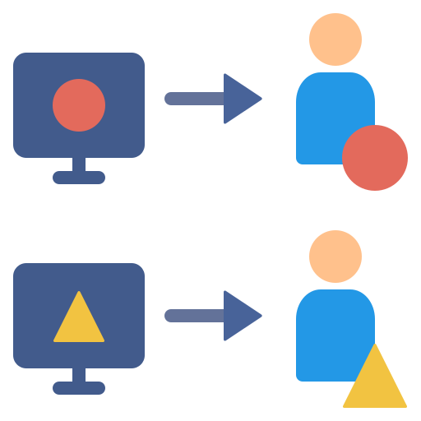


Data Governance for Bumble
— Here is where LOVE begins
Group 8 Grace Abunyie
Ophelia Chen
Shaquille Laing
Tanishka Patil
Notes:
Good afternoon everyone, today we will be pitching an effective data governance program for Bumble - an online dating app!

Slide 2
AGENDA
01
02
About Bumble
Data Governance
03
04
Dating App Data
Potential Risks
05
06
Use Case
Recommendations

Slide 3
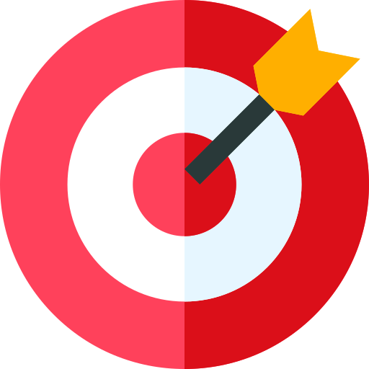

BUMBLE
Company Overview
Bumble is a social networking platform founded in 2014 by Whitney Wolfe Herd. It has evolved into a prominent player in the online dating industry, providing a unique and empowering approach to relationships. Bumble distinguishes itself by giving women the initiative in the connection process, allowing them to make the first move.
Mission & Vision
Key Business Activities
Our mission is to create a world where all relationships are healthy and equitable, through Kind Connections
Bumble operates primarily as a dating app but has expanded its offerings to include Bumble BFF for platonic connections and Bumble Bizz for professional networking.
Notes:
Bumble Inc. is a online dating and social app which was founded by Whitney Wolfe Herd shortly after she left Tinder.
It operates on a location-based swipe model, with a unique feature that only allows women to initiate conversations

Slide 4
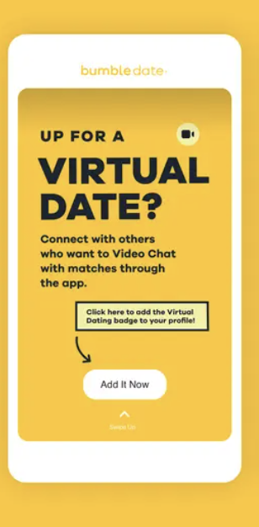
Why Bumble?
01
02
03
Relevance to Contemporary Issues
Corporate
Strategy
Alignment
with Values
Bumble's corporate strategy focuses on innovation, user safety, and social responsibility
Bumble's emphasis on kindness, respect, and safety resonates with the principles of data governance
Given the increasing importance of data privacy and ethical considerations in the tech industry, Bumble serves as an ideal case study.
Notes:
Data governance will help Bumble in following its corporate strategy
By choosing Bumble, we aim to explore how effective data governance can further enhance these values in the digital realm.
We believe that analyzing Bumble's data governance practices can offer valuable insights applicable to broader discussions on responsible technology use

Slide 5
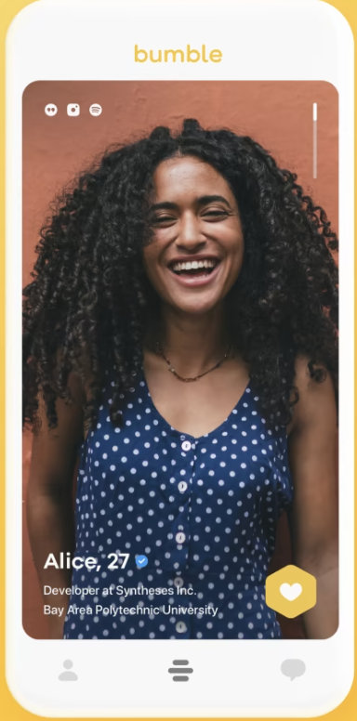
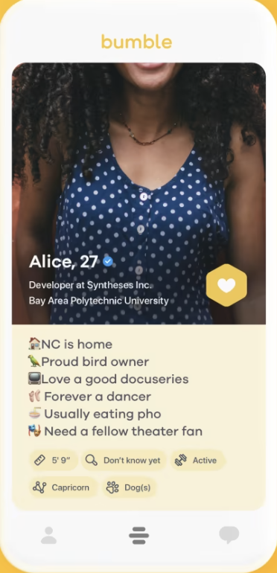

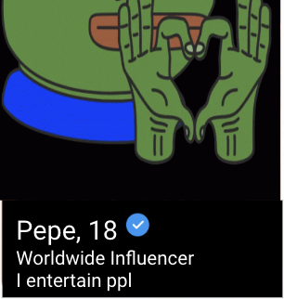


Bumble Collects Pepe’s Data
Name/ Username
Pictures
Phone Number
Location
Birth Date & Time
Gender Identity
Location of Birth
Preferences
Pepe, 18
Worldwide Influencer
I entertain ppl
Bumble Account
Social Media Account

Slide 6
Data Governance - Why is it useful?
Data Minimization:
Risk Management:
This principle ensures that only the data necessary for the intended purpose is collected.
It is significant for dating apps that deal with risks such as the potential for stalking, harassment, or identity theft based on shared personal data.
Regulatory Compliance:
With data governance practices in place, Bumble can adhere to privacy regulations such as GDPR, CPPA, or other regional laws.
Data Quality and Accuracy:
Proper data governance ensures that the data collected is accurate and up-to-date. For Bumble users, accurate data means better matches and an overall improved user experience.
Notes:
For Bumble, data governance would require the app to collect no more personal information than is required to make the service work effectively for the user. Compliance with these regulations is vital to avoid legal issues and fines.
Good data governance helps in mitigating risks associated with data handling.

Slide 7
Potential Risks
Data Privacy
Reputational Risk
02
Sensitive Data collected -
Mishandling can lead to privacy concerns
01
Importance on Brand Image - Damage to reputation can lead to decline in users.
Data Quality Maintenance
Regulatory Compliance
Inaccurate or outdated user data can impact matchmaking algorithms
Evolving regulations by CPPA -
Keeping abreast might increase operational costs
03
04

Slide 8
Risks In Action
“Bumble Vulnerabilities Put Facebook Likes, Locations And Pictures Of 95 Million Daters At Risk” (Forbes, 2020).
Ethical hackers discovered vulnerabilities in Bumble dating app, exposing the private data of its 95 million users.
Bumble's API lacked necessary checks and limits, enabling attackers to easily probe the server for user data and exploit premium features for free.
The vulnerabilities persisted for at least 200 days after researchers alerted Bumble, raising concerns about data security and user privacy.
Bumble took six months to address the issues, highlighting potential delays in responding to security threats and the need for improved data governance practices.

Slide 9
Recommendations - What Could Bumble Do?
Timely Response Protocols
Regular Security Audits
Strengthen API Security Measures
Address reports promptly, implement interim controls, and ensure a quicker overall remediation
Penetration testing at regular intervals to identify and address vulnerabilities.
Implement rigorous authentication and access controls to prevent unauthorized access
Notes:
Whenever they identify a security issue, they shall instantly take care of it while putting temporary measures in place, leading to a faster fix overall. They'll regularly test the systems to find and fix weak spots before they become problems.
Enforce strong verification steps to ensure that only the right people can access sensitive areas of our system.

Slide 10

Conclusion
CONCLUSION
Synergy between our data governance proposal and Bumble's mission.
By implementing our recommendations, Bumble can not only mitigate potential risks but also unlock new opportunities for growth and innovation.
We believe that our team is well-equipped to guide Bumble on this journey, ensuring a seamless integration of data governance into its operations.
Notes:
As we all know, we are aiming at enhancing Bumble’s Mission through Data Governance
With our help, Bumble can both protect itself from data-related risks and find exciting new ways to expand and innovate.
In conclusion, we have the right blend of skills and experience to ensure that incorporating data governance into Bumble's processes is smooth and effective.

Slide 11
References
About Us | Bumble. (2014). Bumble Careers. https://team.bumble.com/about
Brewster, T. (2020, November 16). Bumble Vulnerabilities Put Facebook Likes, Locations And Pictures Of 95 Million Daters At Risk. Forbes. https://www.forbes.com/sites/thomasbrewster/2020/11/15/bumble-vulnerabilities-put-facebook-likes-locations-and-pictures-of-95-million-daters-at-risk/?sh=48bc21ad3ddf
Bumble - Privacy. (2023). Bumble. https://bumble.com/en-us/privacy

Slide 12



